Slide 1
Digital Signatures, Key Management, PKI
15-421/08-731 and 08-761/46-861 -- Fall 2013 – Lecture 4
Information Security & Privacy
Norman M. Sadeh
School of Computer Science
Carnegie Mellon University

Slide 2
Practical Info
Team Project Proposals: due by 5pm on Thursday
Project presentations: nearly finalized
Homework Assignment out by tonight

Slide 3
Overview
Brief recap of what we covered last week
Digital Signatures
Hash Functions & Message Digests
Key Management
  Key Establishment
  Public Key Certificates and PKI
Cryptography: Government regulation
References

Slide 4
Previous lecture
Intro to cryptography
Symmetric versus Asymmetric (or Public Key) Cryptography
Key Exchange Problem
Public Key Cryptography
  Confidentiality mode
  Authentication mode

Slide 5
Computational Considerations
Public key encryption and decryption is computationally much more expensive than symmetric encryption algorithms
In practice, most practical systems use hybrid public/private cryptography
  Use PKC to exchange symmetric session keys

Slide 6
Digital Signatures: Objective
Data item that accompanies a digitally encoded message and that can be used to:
  ascertain the identity of the originator, but also…
  Integrity of the message
  Non-repudiation

Slide 7


Digital Signature: Basic Principle
Transmitted
Message
Message
Message
Message
Sign
Verify
Signature
Signature
Yes/No
Sender’s
Private Key
Sender’s
Public Key
Sender
Recipient

Slide 8
Difference between MAC and Digital Signatures
MACs rely on symmetric keys
  The recipient shares the same key as the sender
  Hence, the recipient could forge the sender’s signature: MACs do not support non-repudiation
Digital signatures provide for non-repudiation, using Public Key Cryptography (PKC):
  The recipient can verify the signature but not forge it

Slide 9
The Need for Message Digests
One simplistic scheme:
  Encrypt the message with your private key and make the result your signature
  Send the message along with the signature
Problems:
  Computationally expensive: encryption and decryption of entire message
  Bandwidth inefficient: doubles the volume of data being sent
    Though one could just send the encrypted message

Slide 10
Cryptographic Hash Functions
One-way function
  Takes an arbitrary block of data & returns a fixed-size bit string
  Function that is easy to compute & difficult to reverse
    y = f(x) is easy to compute
    x=f⁻¹(y) is difficult to compute
Maps values from a possibly very large domain into a comparatively small range
    A message of millions of bits into an output of 160 bits in length
The result of applying a hash function to a message is referred to as a message digest

Slide 11
Digital Signatures Using Message Digests
Transmitted
Message
Expected
Digest
Hash
Function
Message
Message
Message
Hash
Function
Digest
Expected
Digest
Encrypt
Actual
Digest
Signature
Decrypt
Sender’s
Private Key
Match?
Sender’s
Public Key
Sender
Recipient

Slide 12
Properties of Good Hash Functions - I
Has to be truly one-way
  Must be computationally impossible to construct an input message that hashes to a given digest
Otherwise an attacker could substitute another message, while keeping the digital signature unchanged

Slide 13
Properties of Good Hash Functions - II
Two different files should always have different message digests
  In practice, there are possible collisions
Even a small change in a file should result in a substantial change in the digest, e.g.
  MD5(There is $1500 in the blue box)= 05f8cf03f4e58cbee731aa4a14b3f03
  MD5(There is $1100 in the blue box)= 4b3680706169572b804907735accd42
    128 bit message digests

Slide 14
Examples of Hash Functions
US Government’s Secure Hash Algorithm (SHA-1)
  Generates 160-bit digests
RSA’s MD2: Rivest’s most secure message digest function…but also the most computationally intensive – 128 bit digests – not widely used
RSA’s MD4 and MD5 have some known weaknesses
MD5 and SHA-1 are both used in SSL
SHA-256/384/512: 256/384/512-bit hash functions proposed by NIST (designed by NSA) for use with AES
Oct. 2012: NIST selects SHA-3 – another alternative

Slide 15
Business & Computational Considerations
Message digests are much faster to calculate than traditional cryptographic functions
  Otherwise, there would be no point in using them
No patent restrictions on any of today’s MD functions
No export restrictions on MD functions
Uses:
  MACs
  Digital Signatures
  PGP – uses MD function to generate encryption key to encrypt the user’s private key

Slide 16
Pulling it All Together
So far: Authentication, integrity, non-repudiation
How about confidentiality?

Slide 17
Pulling It All Together - II
Message with Digital Signature
Original
Message
Scrambled
Message
Encryption
Digital Signature
Recipient’s Public Key
Original
Message
Internet
Hashing
Message
Digest
Encryption
Sender’s Private Key
In practice, there are a number of different ways of accomplishing this

Slide 18
Key Management
Making keys available to participants
Protecting keys against disclosure and substitution
Different approaches for symmetric and asymmetric cryptosystems

Slide 19
Key’s Limited Lifetime: Motivations
Cryptanalysis is facilitated by having access to large amounts of ciphertext
  Change the keys to avoid making it too easy for potential attackers
Keys can be compromised
  The key owners would not necessarily know
  Limit potential damage by regularly changing your keys

Slide 20
Key Lifecycle Management
Key establishment
  Incl. key generation and distribution
Key backup/recovery or key escrow
Key replacement/update (“rekeying”)
Key revocation
Key expiration/termination
  Possibly including key destruction or key archiving

Slide 21
Symmetric Key Establishment
Key transport/exchange
Key agreement

Slide 22
RSA Key Transport
Establishment of Symmetric Keys
Using RSA to encrypt the symmetric key
  e.g.: email: generate a random symmetric key
    Use RSA to transmit the symmetric key
    Use the (symmetric) key to encrypt the message content

Slide 23

Email Encryption with RSA Key Transport
Transmitted
Message
Expected
Digest
Encrypt
Decrypt
Encrypted
Content
Recipient
Private Key
Plaintext
Content
Plaintext
Content
Encrypted
Key
Encrypt
Decrypt
Symmetric
Key
Symmetric
Key
Recipient
Public Key
Sender
Recipient

Slide 24
Distribution of Public Keys
Symmetric key cryptosystems: need to rely on mechanisms for sharing a key while keeping that key secret to others
Public key cryptosystems:
  Private key remains private
  Public key is published
  Public Key Integrity: Could someone substitute your public key?
    Masquerading attacks

Slide 25
Public Key Certificates
A typical certificate contains:
  A public key
  Other information such as:
    Person’s name, email address, affiliation
  Certification authority – trusted third party
  Validity period
    Start and end dates
The certificate itself is signed with a Certification Authority’s digital signature
Most common certificate format: X.509 defined by the ITU

Slide 26

Simple Public Key Certificate
Certificate
Certification
Authority’s
Private Key
Subject Identification
Information
Public Key
Generate
Digital Signature
Certification Authority’s
Name
Certification Authority’s
Digital Signature

Slide 27
Question
What safeguards do you need to protect the distribution of certificates?
  Should you encrypt certificates when distributing them?
  Should you keep them on secure servers?

Slide 28
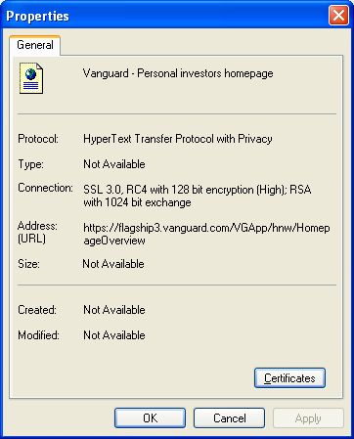
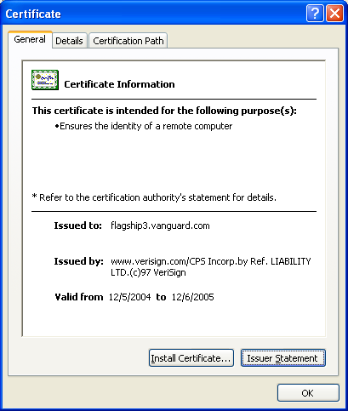
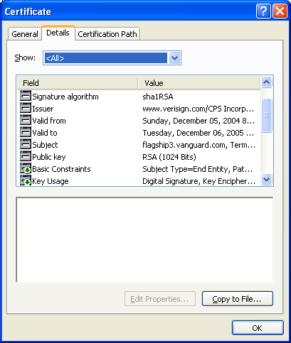
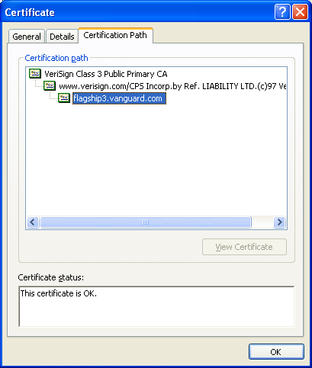
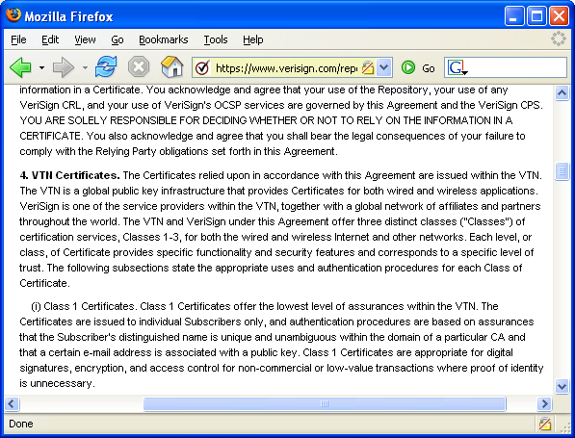
Sample Certificate

Slide 29
Multiple Certification Authorities
Impractical to have a single certification authority
  Requires sufficient knowledge & adequate relationships with all potential subscribers
Multiple certification authorities
  Cannot assume that a public key user holds the public key of all certification authorities

Slide 30
Certification Paths
Public Key User X
knows Public Key
of CA A
Say User X wants to send a
confidential message to User Y …
but Y’s certificate was issued by CA C
Subject: CA B
Subject: CA C
Public Key of B
Public Key of C
Issuer: CA A
Issuer: CA B
Certificate 1
Certificate 2
Subject: User Y
User Y
Public Key of Y
Issuer: CA C
Certificate 3

Slide 31
In practice…
An organization’s root certificate will typically be distributed to its employees
  So they can use the organization’s PKI
  Can have certificates that also specify which part of the organization you work for & use this for access control
Web browsers (e.g. IE, Mozilla, Chrome) come with pre-installed certificates
  SSL certificates from large vendors are immediately recognized
  These large vendors pay for the privilege
  The browser vendor essentially pre-selects trusted CAs
Also prebundled certificates in OSs.

Slide 32
Key Backup/Recovery
Loss of a key may mean loss of information that was encrypted, using that key
  Accidental loss – e.g. hardware failure, lost password
  A disgruntled employee leaves with/destroys the key
Solution: Store encrypted backed-up copies of the keys – and store master key in a really safe place (or places) such as a vault
More controversial: Law enforcement or intelligence organizations
  Recover encrypted data
  Wire tapping

Slide 33
Key Replacement/Update
When key’s “cryptoperiod” expires
Important issues to be considered:
  Information encrypted with old key may still need to remain confidential for many years
  Legitimacy of digital signatures may have to be proved years after the keys were replaced
    Solution: Archive public keys – possibly with a trusted third party

Slide 34
Certificate Revocation: Different Approaches
Periodic Publication of Certificate Revocation Lists (CRLs)
Broadcast CRLs
Online Status Checking
Short-Lived Certificates
etc.

Slide 35
PKI vs. Web of Trust Model
PKI – Public Key Infrastructure model
  Assumes a strict hierarchical model of Certificate Authorities
Web of Trust Model
  Anyone may sign (and thus attest to the validity) of others’ key certificates
  Example: Pretty Good Privacy (PGP)

Slide 36
Regulation of Cryptography
Initial motivation for regulation was military
  e.g. Estimates that cracking the Enigma code during WWII shortened the war by 2-4 years
As e-Commerce took off, industry started to lobby government to relax export restrictions
As cryptography grew cheaper and more widespread, law enforcement started worrying about their ability to conduct search warrants and wiretaps

Slide 37
Wassenaar Treaty
  Allows for export of all mass-market symmetric encryption software or hardware up to 64 bits (without review)
    Above 64 bits requires registration with the BIS (DoC’s Bureau of Industry and Security”)
  Wassenaar Treaty was originally signed in 1996 by 31 countries – incl. the US
  Situation in Europe: The EU has deregulated the transport of cryptographic items
    Exception: “cryptanalysis devices”

Slide 38
Situation Today: Be Careful!
Non-military control of cryptography exports by Dept of Commerce (“Bureau of Industry and Security”)
Need to check against several export lists (e.g. “rogue states” but also “terrorist organizations” and embargoed countries)
Need to self-classify products to determine whether one needs to register or not (according to BIS classification)
Even cryptographic consulting services require a license

Slide 39
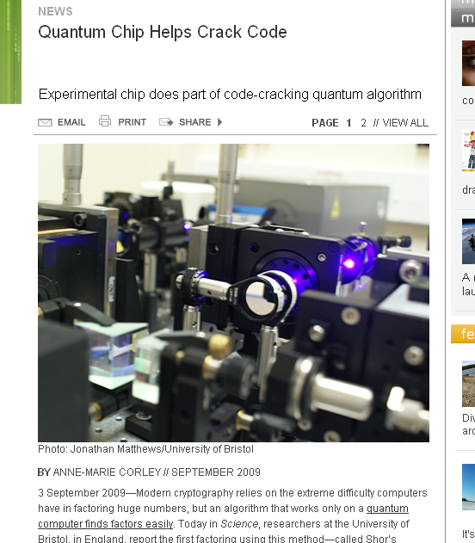
A Word of Caution
IEEE Spectrum,
Sept 2009

Slide 40
References for this Lecture
Web Security, Privacy & Commerce by Garfinkel, O’Reilly, Ch. 4, and 7

Slide 41

Q&A

Slide 42
Bonus Slides
08-761/46-861 -- Fall 2012 – Lecture 4
Web Security, Privacy & Commerce

Slide 43
Diffie-Hellman Key Agreement
Agreement on a symmetric key through exchange of public values associated with randomly generated secrets
A generates random secret value x and computes corresponding public value X
B generates random secret value y and computes corresponding public value Y
A sends X to B and B sends Y to A
A and B can both compute the same symmetric key
  A from x and Y and B from X and y
  Eavesdroppers can’t compute the symmetric key

Slide 44
Diffie Hellman Key Agreement - II
System A
Prior agreement
on non-secret
prime p & value a
System B
Generate secret
random number x
Generate secret
random number y
Compute
a^{x} mod p
a^{x} mod p
Compute
a^{y} mod p
a^{y} mod p
Compute key
(a^{y})^{x} mod p
Compute key
(a^{x})^{y} mod p
Common private key: a^{xy} mod p
Can’t be inferred by an eavesdropper: would have to also know either x or y
Difficulty of computing discrete logarithms

Slide 45
Random Number Generators
Unpredictability of keys depends on unpredictability of random number generators
  Nonce: random number used once to avoid replay attacks
Examples:
  Use hardware random noise source
  Pseudorandom software – relies on secret random initial seed
    Requires careful analysis
    1995: Netscape Navigator keys could be reproduced in about 1 minute – seed of random number generator could be guessed

